Slide 1
Style Guide
&
Wireframe
Peter Cortorreal

Slide 2
Typography
Inspiration
For Headlines use Gilda Display, size 20px
For Body use Arapey, size 14px
Nullam ut est laoreet, accumsan diam sit amet, dapibus felis. Morbi sagittis molestie dictum. Pellentesque purus lacus, cursus eget varius ac, consequat tristique urna. Donec malesuada libero eget augue lacinia ultricies.

Slide 3
CSS
Margin: 0px
Padding: 0px
Display: grid
Columns: 5
Column-gap: 2px
Media Queries inclue:
- Laptops: 13”,15”, 17”
- HTC/Samsung Galaxy
- iPhone 5,5S,6,6+,7,7+

Slide 4
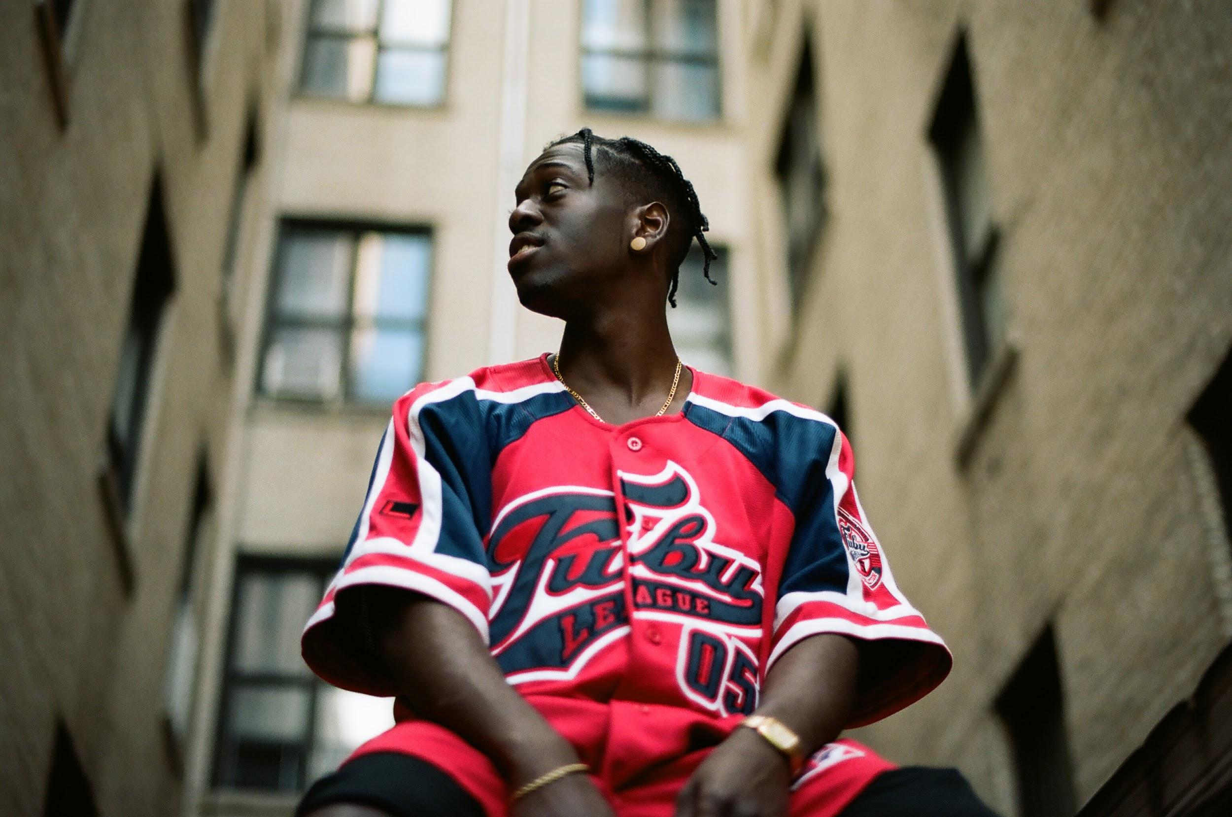
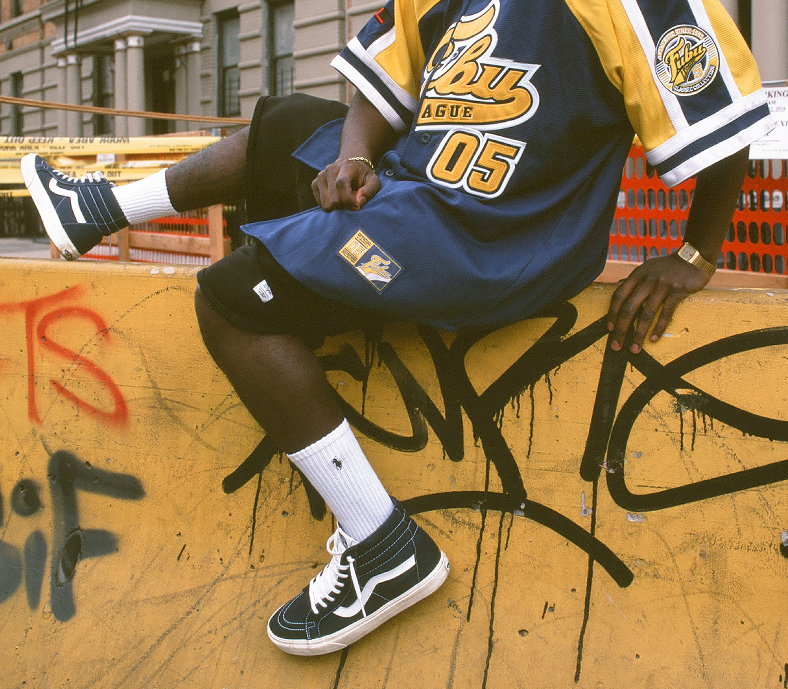
Photography
The website will feature the blogger’s designs, photography, and fashion. Representing content of an online Zine.
Images with high resolution, 300 ppi.

Slide 5

Icons
Logo

Slide 6
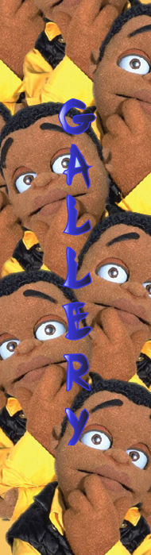
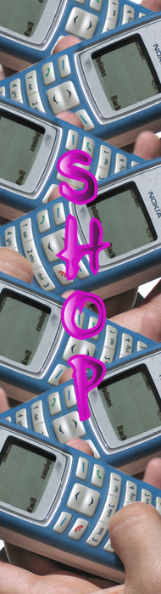
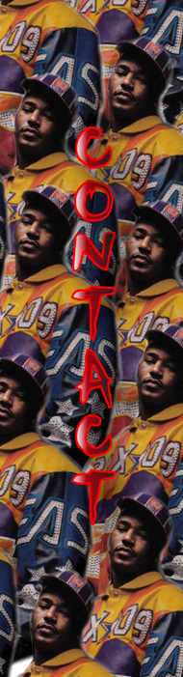
Icons
Navigation Bar

Slide 7

Icons
Footer

Slide 8

Color
Theme 17: (left to right)
#CCD6DF
#727265 - Header 1
#AFA17D
#2A302F - Body Text
#27271F - Header 2

Slide 9
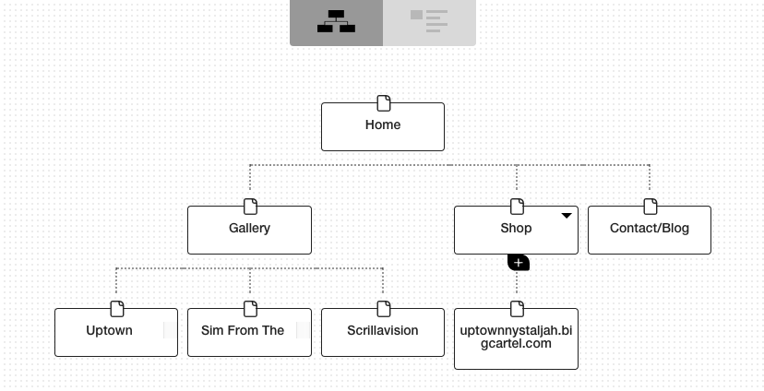
Wireframe

Slide 10
3.30.17
Thanks for viewing!

